Slide 1
Creating an Array Based Vector Step by Step

Slide 2
Content
The Vector ADT
The ArrayBasedVector
2
Notes:
2/28/2020
2
2

Slide 3
The Vector ADT
The Vector ADT is best represented as an interface.
This maps to the definition of an ADT, because the interface will define the Data Type will work from the users’ perspective without defining HOW it will carry out the tasks required.
3
Notes:
2/28/2020
3
3

Slide 4
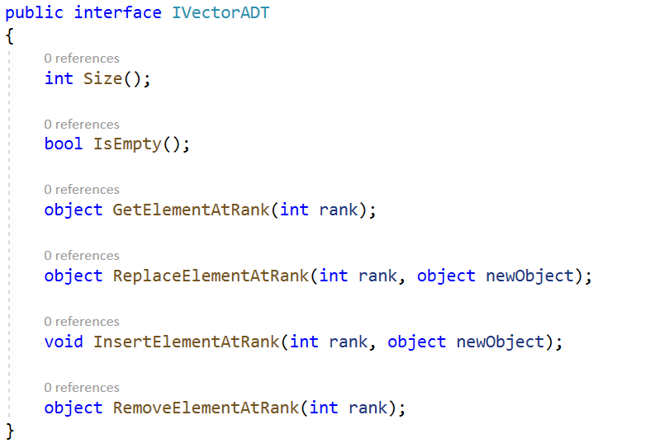
The Vector ADT
By looking at the definition of the VectorADT from the slides, the following operations need to be added to the interface.
4
Notes:
2/28/2020
4
4

Slide 5
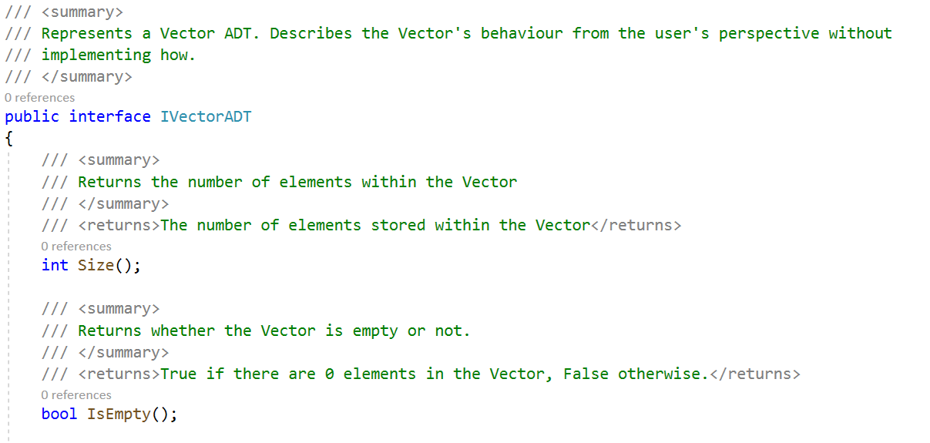
The Vector ADT
By looking at the definition of the VectorADT from the slides, the following operations need to be added to the interface.
5
Notes:
2/28/2020
5
5

Slide 6
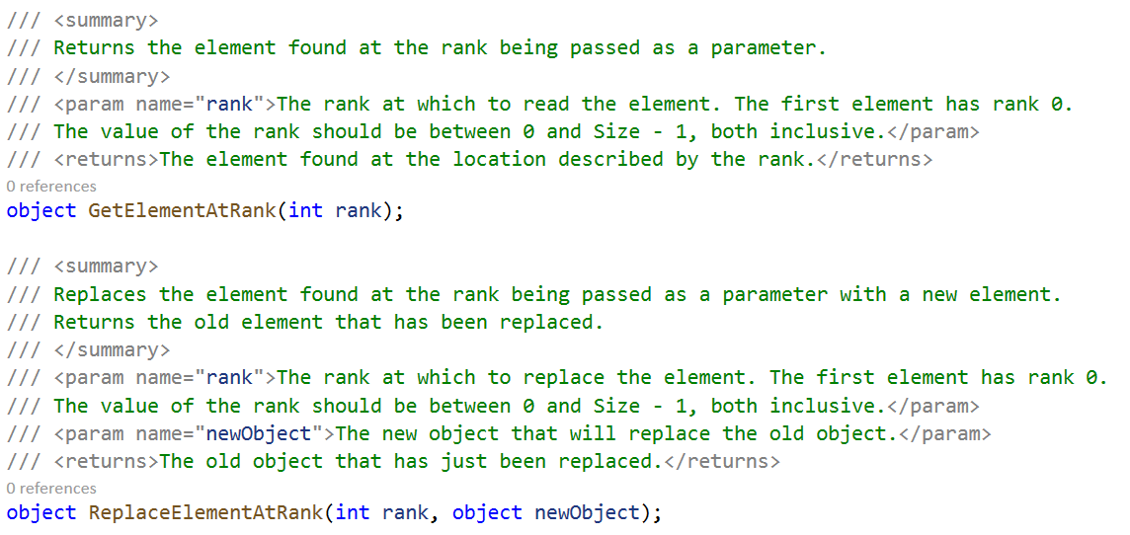
The Vector ADT
By looking at the definition of the VectorADT from the slides, the following operations need to be added to the interface.
6
Notes:
2/28/2020
6
6

Slide 7
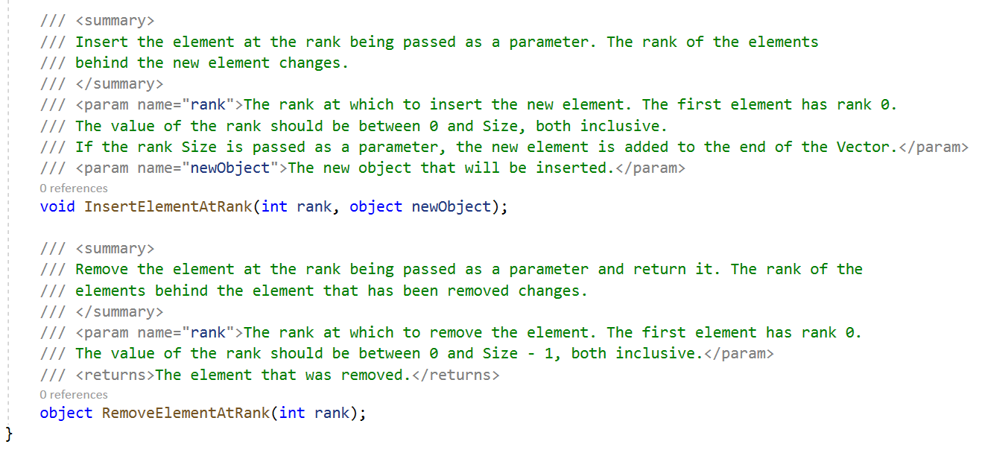
The Vector ADT
By looking at the definition of the VectorADT from the slides, the following operations need to be added to the interface.
7
Notes:
2/28/2020
7
7

Slide 8
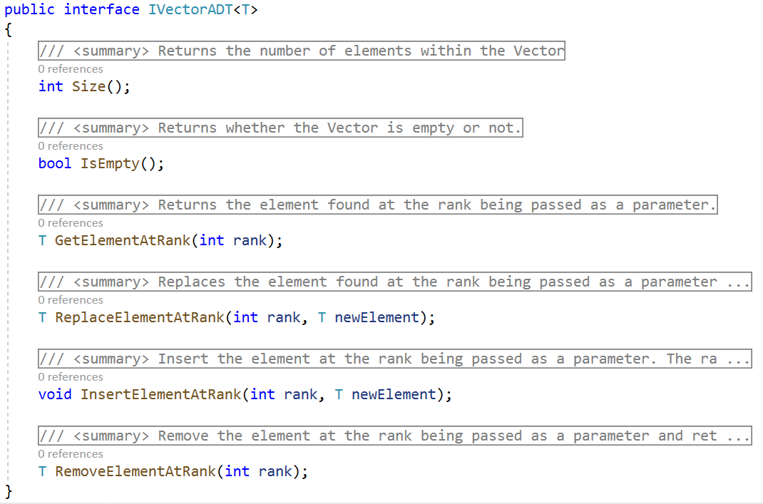
The Vector ADT
The interface can be modified to use Generics, thus making programing easier later, since boxing and unboxing from objects will be avoided.
8
Notes:
2/28/2020
8
8

Slide 9

The Vector ADT
The interface can be modified to use Generics, thus making programing easier later, since boxing and unboxing from objects will be avoided.
9
Notes:
2/28/2020
9
9

Slide 10
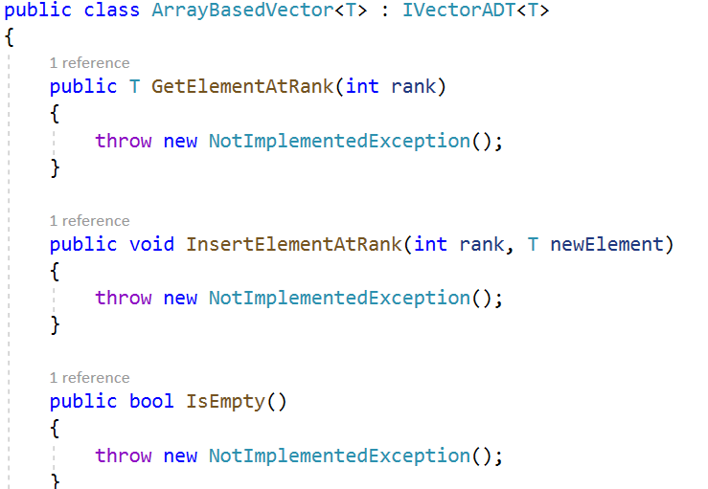
The ArrayBasedVector
The ArrayBasedVector is a concrete implementation of the Vector ADT.
It is best represented as a class that implements the interface.
An ArrayBasedVector uses an array to implement the Vector.
10
Notes:
2/28/2020
10
10

Slide 11
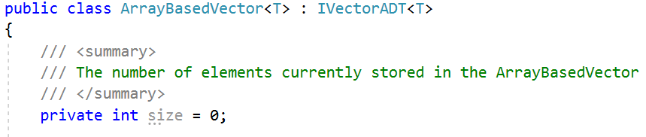
The ArrayBasedVector
To implement the ArrayBasedVector, first the required fields that will store the data need to be defined.
An integer that will store the current number of elements is required.
11
Notes:
2/28/2020
11
11

Slide 12
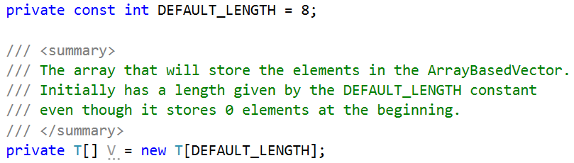
The ArrayBasedVector
Additionally the structure required to store the elements is also required. The ArrayBasedVector will store all the elements in an array.
The array has the space to store any elements that will be added later.
12
Notes:
2/28/2020
12
12

Slide 13
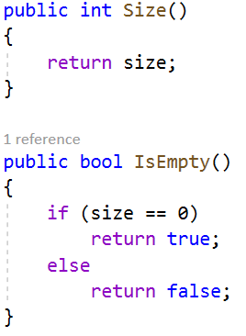
The ArrayBasedVector
The Size and IsEmpty operations are easy to implement.
13
Notes:
2/28/2020
13
13

Slide 14
The ArrayBasedVector
The GetElementAtRank returns the element with “rank” number of elements before it.
Since there are no gaps in the ArrayBasedVector, the position of the element in the array is the rank.
The element at index 0, has 0 elements before it.
The element at index 1, has 1 element before it.
The element at index 2, has 2 elements before it,
etc…
14
Notes:
2/28/2020
14
14

Slide 15
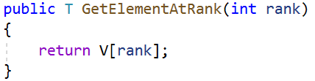
The ArrayBasedVector
The basic implementation of the GetElementAtRank is as below. However, notice that some problems can happen!
Can you identify the potential problems with this implementation?
15
Notes:
2/28/2020
15
15

Slide 16
The ArrayBasedVector
The method below could accept a rank that is outside the bounds of the array V.
Furthermore, if there are few elements, a rank can be passed as a parameter that is outside the acceptable range – that is, a rank can be passed for which there is no element with the rank passed as a parameter.
16
Notes:
2/28/2020
16
16

Slide 17
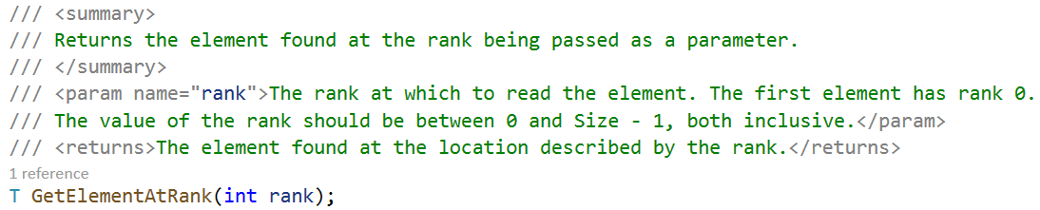
The ArrayBasedVector
In fact, the definition of GetElementAtRank states that:
17
Notes:
2/28/2020
17
17

Slide 18
The ArrayBasedVector
To solve this issue, the parameters should be checked!
18
Notes:
2/28/2020
18
18

Slide 19
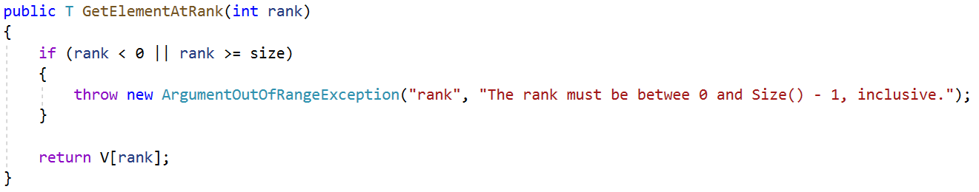
The ArrayBasedVector
To solve this issue, the parameters should be checked!
19
Notes:
2/28/2020
19
19

Slide 20
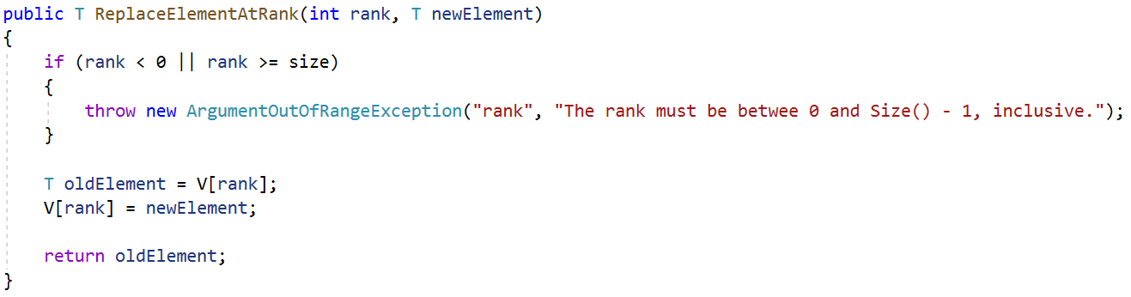
The ArrayBasedVector
The ReplaceElementAtRank method is similar to the GetElementAtRank.
20
Notes:
2/28/2020
20
20

Slide 21
The ArrayBasedVector
The trickier implementations are the InsertElementAtRank and the RemoveElementAtRank, because they have to change the number of elements and keep the ranks of all the elements organized.
21
Notes:
2/28/2020
21
21

Slide 22
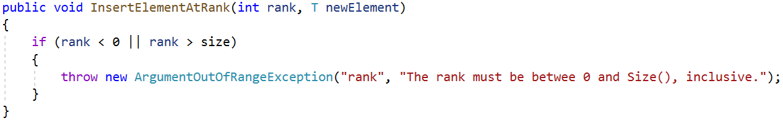
The ArrayBasedVector
InsertElementAtRank, like the other operations, also needs validation.
Notice however, that the rank Size is allowed. This enables new elements to be added to the end of the Vector (or to add the first element in an empty Vector).
22
Notes:
2/28/2020
22
22

Slide 23
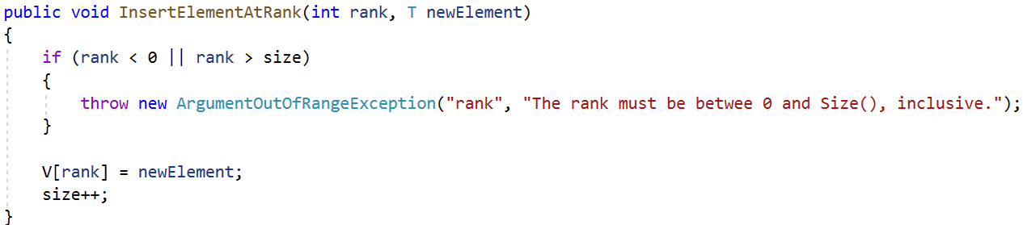
The ArrayBasedVector
It is important to be careful when adding new elements.
The following code has a problem.
23
Notes:
2/28/2020
23
23

Slide 24
The ArrayBasedVector
If there already is an element at the position defined by the rank, it is overwritten.
Therefore, the other elements need to be moved backwards.
24
Notes:
2/28/2020
24
24

Slide 25
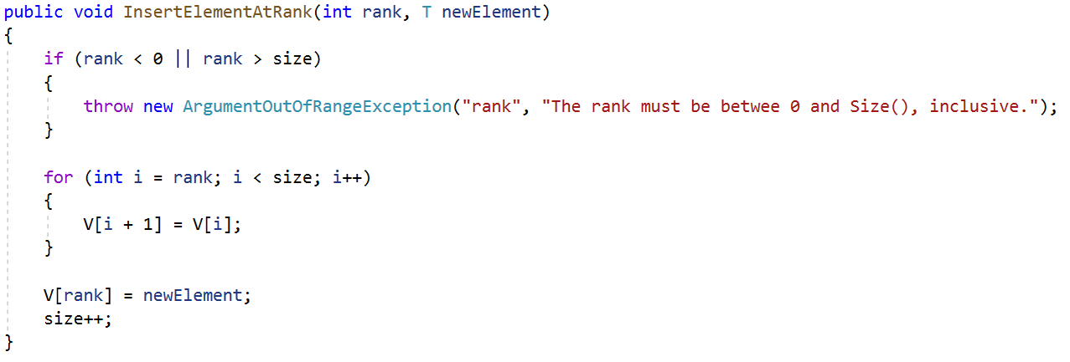
The ArrayBasedVector
Try and debug the following code.
What happens when adding multiple elements at rank 0?
25
Notes:
2/28/2020
25
25

Slide 26
The ArrayBasedVector
When moving the elements backwards, the old elements in other ranks are being overwritten by the same element!
Also, it is possible to run out of space in the array.
26
Notes:
2/28/2020
26
26

Slide 27
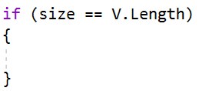
The ArrayBasedVector
When the Length of the array is equal to the size of the array, the array is full and cannot hold any new elements.
Therefore, we need a bigger array to hold the new element!
27
Notes:
2/28/2020
27
27

Slide 28
The ArrayBasedVector
To solve this issue, we need to create a new array which is larger than the old one.
All the elements from the old array need to be copied to the new array.
28
Notes:
2/28/2020
28
28

Slide 29
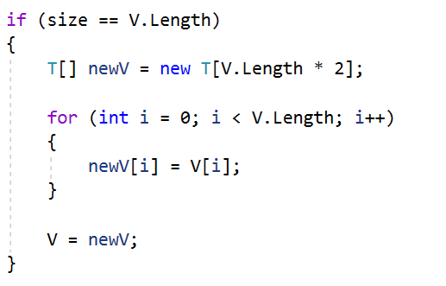
The ArrayBasedVector
This code creates a new array that is twice as long as the old array. This is typical in an ArrayBasedVector and is used to make sure that the InsertElementAtRank does not require to create too many new arrays.
29
Notes:
2/28/2020
29
29

Slide 30
The ArrayBasedVector
Next, all the elements from the old array are copied into the new array.
Finally, the new array replaces the old array.
30
Notes:
2/28/2020
30
30

Slide 31
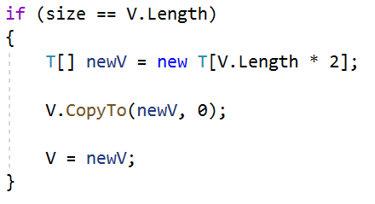
The ArrayBasedVector
This implementation is identical to the one before it.
Even though there is no loop to copy the elements, the CopyTo method is copying the elements from the old array to the new array (in a loop that is hidden from code).
31
Notes:
2/28/2020
31
31

Slide 32
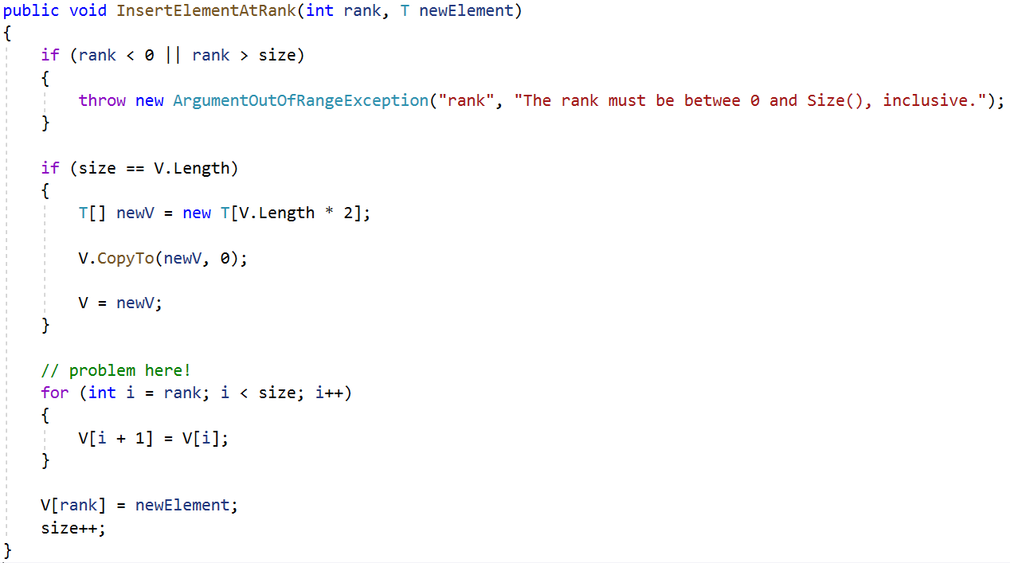
The ArrayBasedVector
At the moment, we have the following code:
32
Notes:
2/28/2020
32
32

Slide 33
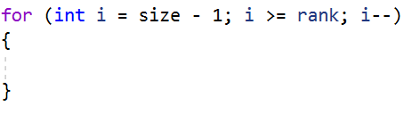
The ArrayBasedVector
To solve the problem when moving the elements out of the way to make space for the new element, the loop needs to start moving elements from the last rank.
This loop, starts with i pointing at the last element in the array and moves backwards until it arrives at the rank where the new element needs to go.
33
Notes:
2/28/2020
33
33

Slide 34
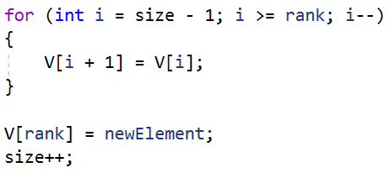
The ArrayBasedVector
To make room for the new element, the other elements need to be moved, one by one, until the position at rank is free for the new element.
34
Notes:
2/28/2020
34
34

Slide 35
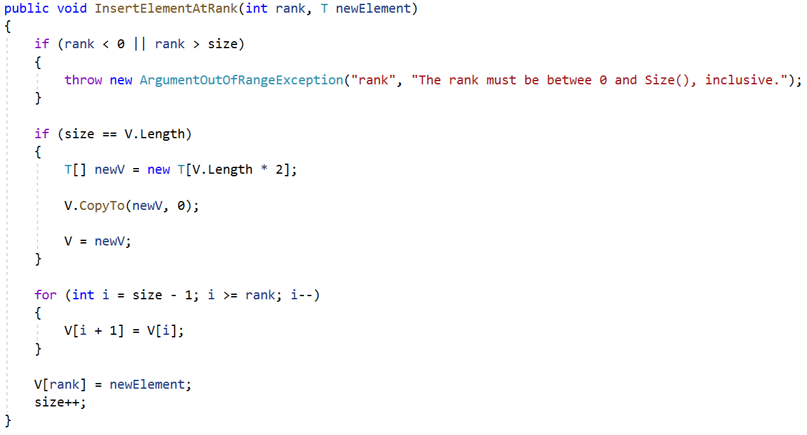
The ArrayBasedVector
This is the complete code. Don’t forget to increment the size!
35
Notes:
2/28/2020
35
35

Slide 36
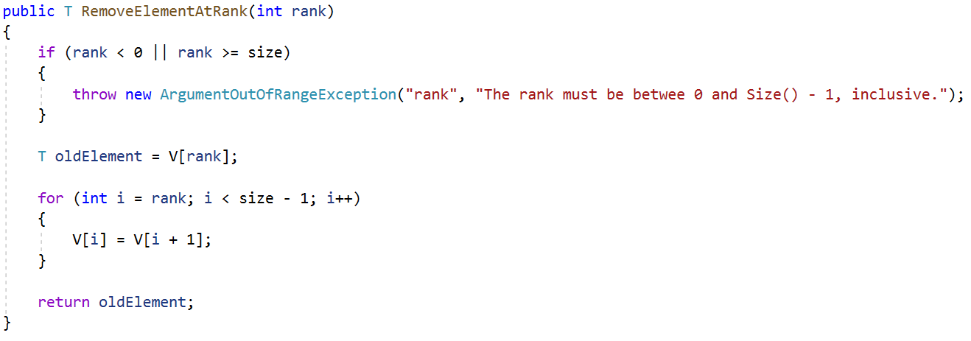
The ArrayBasedVector
The RemoveElementAtRank is similar to the previous method.
Notice that in this case, the loop starts from rank and keeps going up to rank – 2.
The element at rank – 1 is never removed with this code.
36
Notes:
2/28/2020
36
36

Slide 37
The ArrayBasedVector
In some cases, this can be fine. However, it may lead to a memory leak if a lot of data is left unremoved in the array.
37
Notes:
2/28/2020
37
37

Slide 38
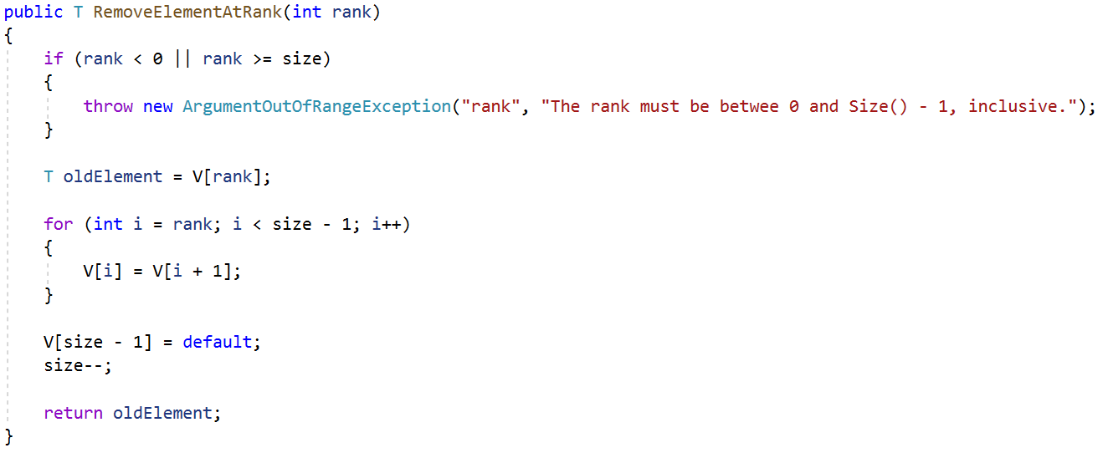
The ArrayBasedVector
This updated code removed the element at rank size – 1.
Don’t forget to decrement the size once the element is successfully removed!
38
Notes:
2/28/2020
38
38

